Slide 1
Minor Project Review – I
Project Title : Password Manager using AI Authentication.
Batch – A3 :
19K41A0513 - K.Rishinandan
19K41A0517 - Mohammed Raamizuddin
19K41A0560 - V.Sai Likhitha
Project Guide
Dr. T Sampath Kumar

Slide 2
Project Domain :
Password Management for various websites and applications for a user.
Objective :
The objective of this Application is to Store and retrieve passwords for different accounts over the internet or various applications using an advanced AI based authentication system which authenticates the user on his/her behaviour.

Slide 3
Existing System :
The Password Management is done manually where the Users themselves should remember the list of passwords for different accounts they hold.
The users should manually maintain a list of all usernames and passwords. This task is very tedious.
In cases where privacy for user accounts is required, it is difficult to manually maintain this list of passwords.

Slide 4
Existing System : (Cont’d)
The users should save password details in some text format so that it will help him to remember the username and passwords for different accounts on the internet.
The password managers embedded in the web-browsers are risky since there is a chance of exposure of this sensitive information.

Slide 5
Proposed System :
Our Password Manager Application has a graphical user interface developed using Java. It allows the user to add account information for different accounts he/she holds over the internet or any application.
Our Password Manager basically stores the username and password details in an encrypted format in the database. The encryption is managed by a symmetric key encryption algorithm.

Slide 6
Proposed System : (Cont’d)
The user has to login to the system, it checks for the
validity of the user using a master username and
password which will be verified by a neural network
for that user specific behaviour.
Once the user is logged in, he/she shall be able to manage the passwords that is stored by them into the encrypted database.
The Passwords are always encrypted so that there is no risk of exposure to unauthenticated persons.

Slide 7
Modules :
User Authentication Module: This module will have the fields to authenticate the user. It has the username and password fields.
User Accounts-passwords Module: This module will have the details regarding the different accounts held by the user over the internet and various applications (i.e. their passwords and usernames).

Slide 8
Technologies :
Java.
Neural Network Algorithm for authentication.
MySQL Database.
Methodologies :
Security.
Encryption.
Behavioral Authentication.

Slide 9
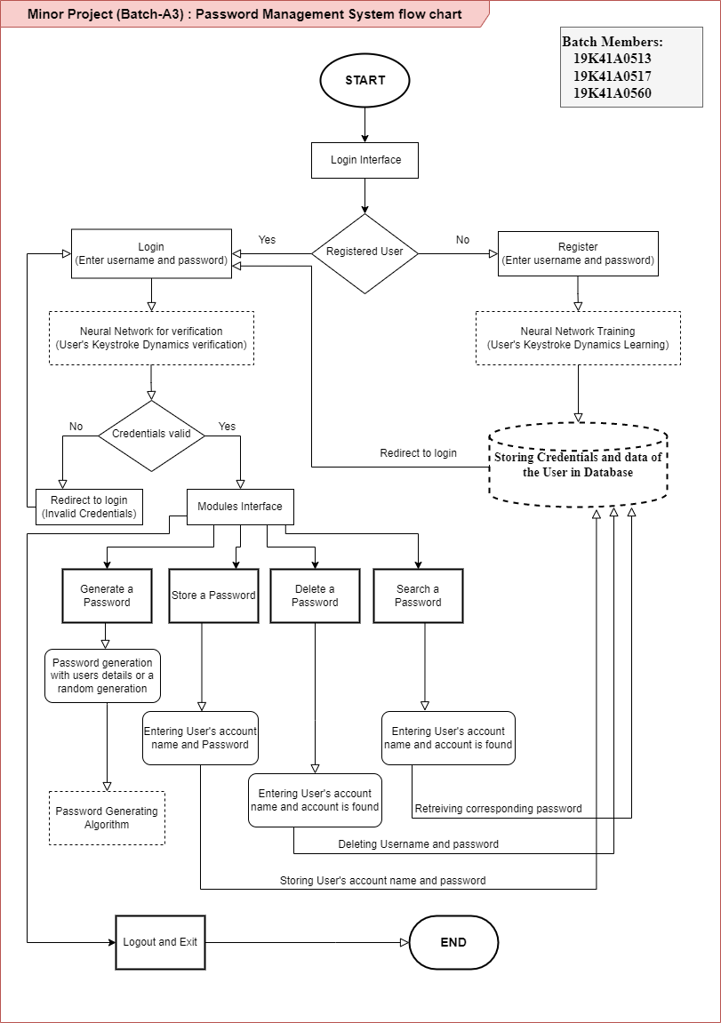
Flowchart of the
system :

Slide 10
Thank you

